Slide 1
CHAPTER 4
Software
Project
Management
Dhara Sharma Dept. of Computer Engineering LJ Polytechnic

Slide 2
Software Project Management
Why Project Fail?
Changing customer requirement
Ambiguous/Incomplete requirement
Unrealistic deadline
An honest underestimate of effort
Predictable and/or unpredictable risks
Technical difficulties
Miscommunication among project staff
Dhara Sharma Dept. of Computer Engineering LJ Polytechnic

Slide 3
Software Project Management
People
Player of the project:
The Stakeholders
Team leaders
The Software Team
Agile Team (Implementer)
Coordination and Communication Issues.
Dhara Sharma Dept. of Computer Engineering LJ Polytechnic

Slide 4
Software Project Management
Stakeholders
Senior managers who define the business issues that often have significant influence on the project.
Project (technical) managers who must plan, motivate, organize, and control the practitioners who do software work.
Practitioners who deliver the technical skills that are necessary to engineer a product or application.
Customers who specify the requirements for the software to be engineered and other stakeholders who have a peripheral interest in the outcome.
End-users who interact with the software once it is released for production use.
Dhara Sharma Dept. of Computer Engineering LJ Polytechnic

Slide 5
Software Project Management
Team Leaders
MOI model for leadership
Motivation The ability to encourage (by “push or pull”) technical people to produce to their best ability.
Organization The ability to mold existing processes (or invent new ones) that will enable the initial concept to be translated into a final product.
Ideas or Innovation. The ability to encourage people to create and feel creative even when they must work within bounds established for a particular software product or application.
Characteristics of effective project managers (problem solving, managerial identity, achievement, influence and team building)
Dhara Sharma Dept. of Computer Engineering LJ Polytechnic

Slide 6
Software Project Management
Software Teams
How to lead?
How to organize?
How to collaborate?
How to motivate?
How to create good ideas?
Dhara Sharma Dept. of Computer Engineering LJ Polytechnic

Slide 7
Software Project Management
Software Teams
The following factors must be considered when selecting a
software project team structure ...
The difficulty of the problem to be solved
The size of the resultant program(s) in lines of code or function points
The time that the team will stay together (team lifetime)
The degree to which the problem can be modularized
The required quality and reliability of the system to be built
The rigidity of the delivery date
The degree of sociability (communication) required for the project
Dhara Sharma Dept. of Computer Engineering LJ Polytechnic

Slide 8
Software Project Management
Team Coordination & Communication
Formal, impersonal approaches
include software engineering documents and work products (including source code), technical memos, project milestones, schedules, and project control tools, change requests and related documentation, error tracking reports, and repository data.
Formal, interpersonal procedures
focus on quality assurance activities applied to software engineering work products. These include status review meetings and design and code inspections.
Dhara Sharma Dept. of Computer Engineering LJ Polytechnic

Slide 9
Software Project Management
Team Coordination & Communication
Informal, interpersonal procedures
include group meetings for information dissemination and problem solving and “collocation of requirements and development staff.”
Electronic communication
encompasses electronic mail, electronic bulletin boards, and by extension, video-based conferencing systems.
Interpersonal networking
includes informal discussions with team members and those outside the project who may have experience or insight that can assist team members.
Dhara Sharma Dept. of Computer Engineering LJ Polytechnic

Slide 10
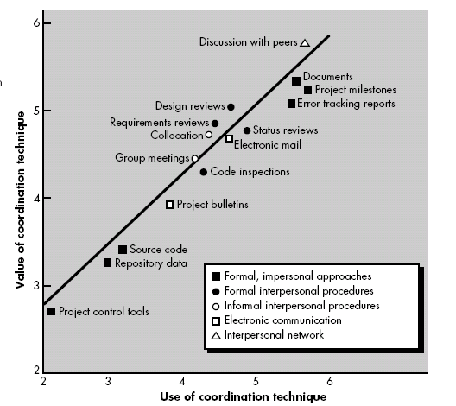
Software Project Management
Dhara Sharma Dept. of Computer Engineering LJ Polytechnic

Slide 11
Software Project Management
Product Scope
Software Scope:
Context How does the software to be built fit into a larger system, product, or business context and what constraints are imposed as a result of the context?
Information objectives What customer-visible data objects are produced as output from the software? What data objects are required for input?
Function and performance What function does the software perform to transform input data into output? Are any special performance characteristics to be addressed?
Software project scope must be unambiguous and understandable at the management and technical levels.
Dhara Sharma Dept. of Computer Engineering LJ Polytechnic

Slide 12
Software Project Management
Process, project and measurement
Process Metrics:-
Are collected across all projects and over long periods of time. Their intent is to provide a set of process indicator that lead to long term software process improvement.
Project Metrics:-
enables a software project manager to
Assess the status of an ongoing project
Track potential risks.
Uncover problem areas before they go “Critical”
Adjust work flow or tasks
Evaluate the project team’s ability to control quality of software work products.
Measurement :-
Are collected by a project team and converted into process metrics during software process improvement.
Dhara Sharma Dept. of Computer Engineering LJ Polytechnic

Slide 13
Software Project Management
Process Metrics & Software Process Improvement
Dhara Sharma Dept. of Computer Engineering LJ Polytechnic

Slide 14
Software Project Management
Process at the center connecting 3 factors that have a profound influence on software quality and organizational performance.
Process triangle exists within a circle of environmental conditions that include the development environment, business conditions and customer characteristics.
We measure the efficacy of a software process indirectly.
That is, we derive a set of metrics based on the outcomes that can be derived from the process.
Outcomes include
measures of errors uncovered before release of the software
defects delivered to and reported by end-users
work products delivered (productivity)
human effort expended
calendar time expended
schedule conformance
other measures.
We also derive process metrics by measuring the characteristics of specific software engineering tasks.
Dhara Sharma Dept. of Computer Engineering LJ Polytechnic

Slide 15
Software Project Management
Software Measurement
Categories in 2 ways:
Direct measure of the software process & Product
E.g. Lines of code (LOC), execution speed, and defect)
Indirect measures of the product that include functionality, complexity, efficiency, reliability, maintainability etc.
Team A found : 342 errors
Team B found : 184 errors
It is depends on size or complexity of the projects.
Dhara Sharma Dept. of Computer Engineering LJ Polytechnic

Slide 16
Software Project Management
Size-Oriented metrics
Size-oriented metrics measures on LOC as normalization value.
Errors per KLOC (thousand lines of code)
Defects per KLOC
$ per LOC
Pages of documentation per KLOC
Errors per person-month
Errors per review hour
LOC per person-month
$ per page of documentation
Dhara Sharma Dept. of Computer Engineering LJ Polytechnic

Slide 17
Software Project Management
End
Of
Chapter
Dhara Sharma Dept. of Computer Engineering LJ Polytechnic

